Slide 1
The Rock Cycle
Igneous Rocks
Volcanoes
Earth and Space Science

Slide 2
The Rock Cycle-
Minerals form rocks
All rocks can be transformed into other rock types
Rocks are divided into 3 categories
Igneous- crystalline- forms as liquid cools
Metamorphic- crystalline-forms as rocks are
heated and squeezed
Sedimentary- non-crystalline- smaller pieces
or chemicals from other rocks

Slide 3
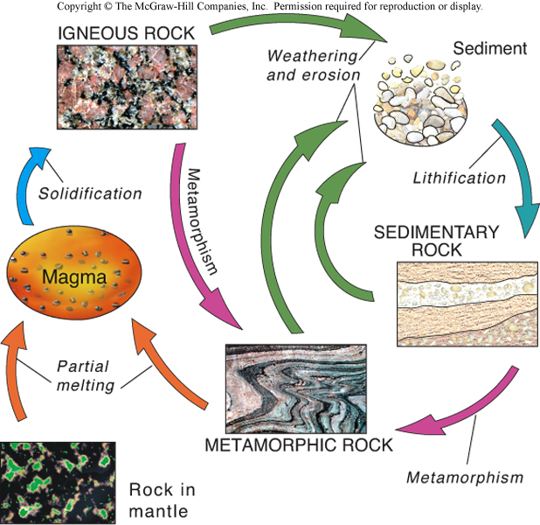
The Rock Cycle
A rock is a naturally formed, consolidated material usually composed of grains of one or more minerals
The rock cycle shows how one type of rocky material gets transformed into another
  Representation of how rocks are formed, broken down, and processed in response to changing conditions
  Processes may involve interactions of geosphere with hydrosphere, atmosphere and/or biosphere
  Arrows indicate possible process paths within the cycle

Slide 4
The Rock Cycle
The continuous process that forms and changes rocks on Earth’s surface and deep below the surface
A rock is composed of grains of one or more minerals
The rock cycle shows how one type of rocky material is transformed into another

Slide 5
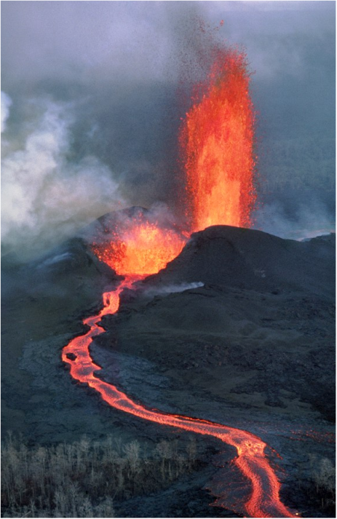
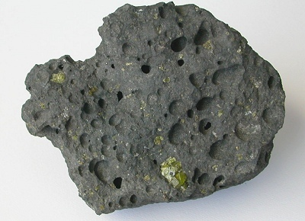
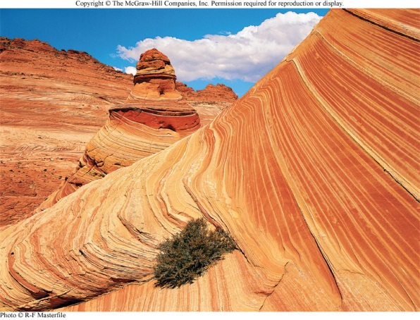
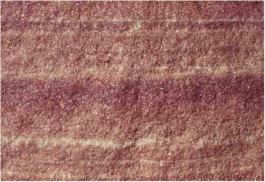
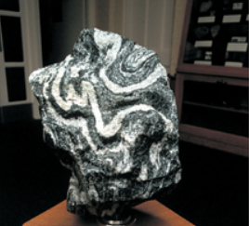
Three Types of Rocks
Igneous rocks - Formed from volcanic eruptions - either external or internal
Sedimentary rocks - Formed from erosional processes
Metamorphic rocks - Deforming of rocks above from exposure to high pressure and temperature

Slide 6
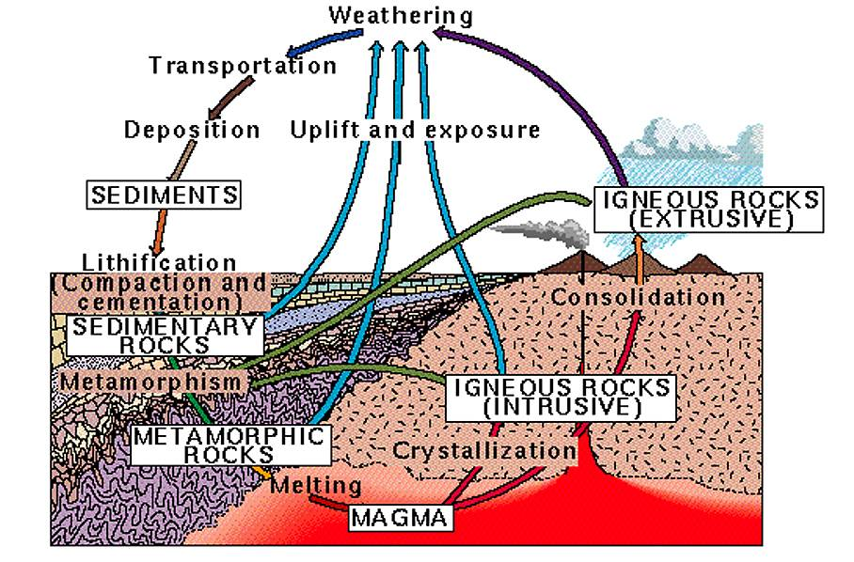

Slide 7
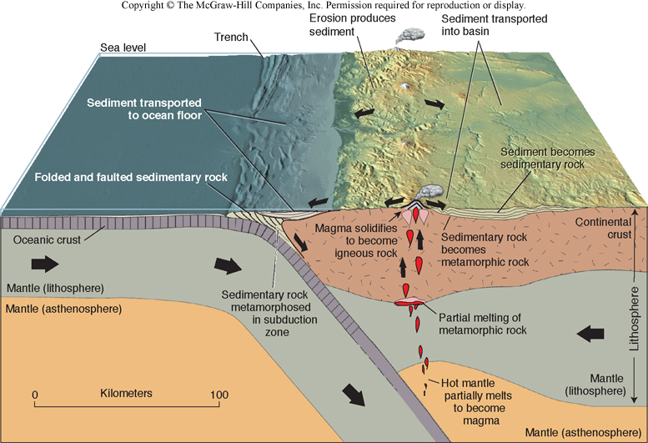
The Rock Cycle and Plate Tectonics
Magma is created by melting
above a subduction zone
Less dense magma rises and cools to form igneous rock
Igneous rock exposed at surface
gets weathered into sediment
Sediments transported to low areas,
buried and hardened into sedimentary rock
Sedimentary rock heated and squeezed at depth to form metamorphic rock

Slide 8

The Rock
Cycle

Slide 9
Igneous Rocks formed from
Magma and Lava
Magma
•
molten rock below Earth's
surface.
L
ava
•
magma on the Earth's surface.
Pyroclastic material
•
(
pyro
= fire,
clastic
= debris)
•
Airborne lava
—
cools as it falls

Slide 10
What factors may influence what type of igneous rocks may form?

Slide 11
Composition of the magma
•
Analogous to what makes up the “stew"
•
What chemical elements are present
•
What material has the magma moved
through
Temperature of the melt
•
Not only how hot, but how long it stays that hot
•
also relates to pressure of the molten rock
Cooling environment
•
fast
vs
slow
•
Internal vs External
Water content

Slide 12
Bowen's Reaction Series-
not in your text, but important
Plagioclase
Olivine
(Ca-feldspar)
Pyroxene
Continuous
Discontinuous
Amphibole
Plagioclase
Biotite
(Na-feldspar)
Orthoclase
(K-feldspar)
Muscovite
Quartz

Slide 13
What things might you describe when looking at an igneous rock?

Slide 14
Composition of Igneous rocks
Felsic or Sialic
magma
•
Si-rich (> 65%)
•
rich in K, and Al
•
little Ca, Fe, and Mg.
Intermediate magma
•
between the two extremes in Si
content and other atoms.
Mafic
magma
•
Si - poor (< 35%)
•
richer in Ca, Fe, and Mg.

Slide 19
Igneous Rocks
– Rocks formed from cooled and hardened magma or lava
- Made of crystals of various minerals
- Mineral crystal size depends on how fast the magma / lava cools
→ Cools slowly = bigger crystals
→ Cools quickly = smaller crystals
- As liquid rock cools, the crystals form and grow

Slide 20
Igneous Rocks
- Types of igneous rock
1. Extrusive igneous rock – cools on the Earth’s surface (above the crust)
→ ex. Obsidian, Basalt (ocean floor rock)
2. Intrusive igneous rock – magma cools inside the Earth slowly
→ ex. Granite

